Slide 1
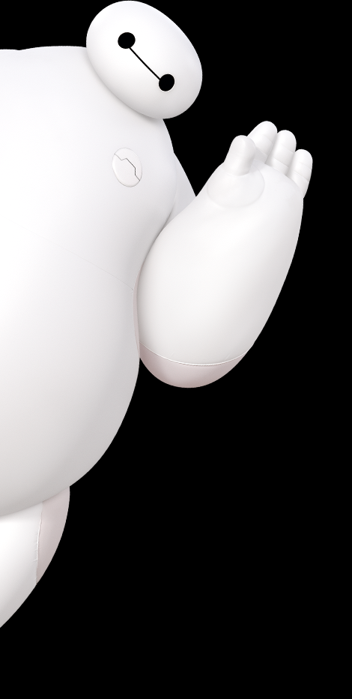
BAYMAX
PROJECT
Saqif Abrar | Shaiza Hashmi

Slide 2
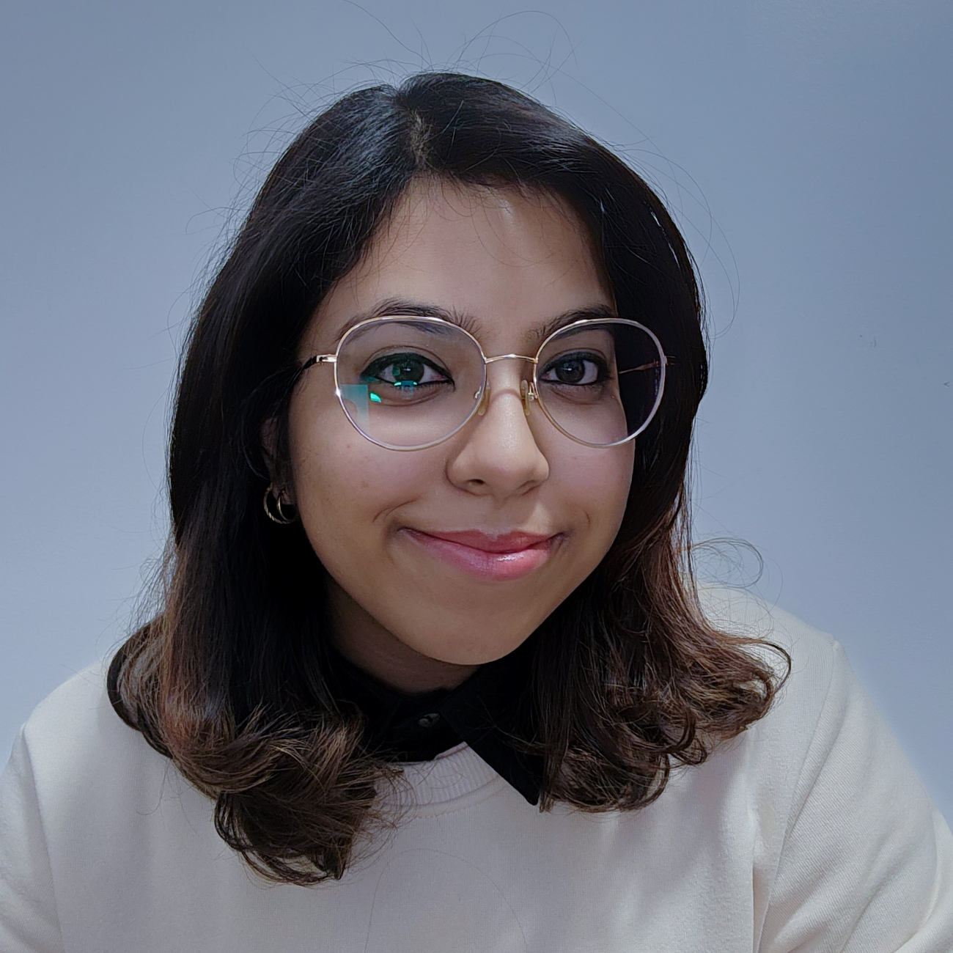

The Team
Shaiza Hashmi
Fullstack Developer
Saqif Abrar
Fullstack Developer

Slide 3








Tools n tech

Slide 4
Overview
The passion project of two curious kids who were inspired!
Baymax is a robot personal health care companion who can measure the well-being of a patient.
We hope to create an AI health care companion built on top of quality data to provide a a simple and friendly user experience for patients of all kinds.
Considering the leaps and bounds technology has made in the past few years, Baymax is becoming closer and closer to becoming a reality

Slide 5
Application
A healthcare companion can be expanded to various aspects.
It provides patients an outlet to monitor their health over a long period of time.
Can serve as a form of diagnosis after a certain level of confidence has been reached.
Can be extended to hospitals complete several tasks such as patient history summarization, utilize diagnostic tools and more.
Reduces mortality rate from missed details during handover between doctors

Slide 6
Demo

Slide 7
Challenges + Learning Opportunities
First time utilizing LLMs and training speech models!
First time incorporating a 3d model on the web
Difficulty navigating and integrating AI APIs to the new and more complex architecture of Next.js 13.
Creating the perfect and identical AI voice model
Fitting the AI model to accurately respond to various randomized prompts with the correct style and manner of speech
Returning and handling streams of text and speech

Slide 8
The Future of To-Dos!
Optimize the chat language model to be flexible and precise.
Optimize the voice cloning to be more accurate to the movie.
Develop the exoskeleton and the inflatable frame.
Incorporate hardware medical tools including temperature scanners, blood oxidation, and more!
The new generation of doctors can grow with this technology, to optimize collaboration

Slide 9
BAYMAX
We hope you are satisfied with your care!

